Slide 1



Introduction to the Geomagic Touch haptic device and the relative software libraries
Faculty of Information Engineering, Computer Science and Statistics
M.Sc. in Artificial Intelligence and Robotics
AA 2015-2016
Professor:
Alessandro De Luca
Presenters:
Andrea Gigli, Antonio Cifonelli, Irvin Aloise, Mirco Colosi

Slide 2
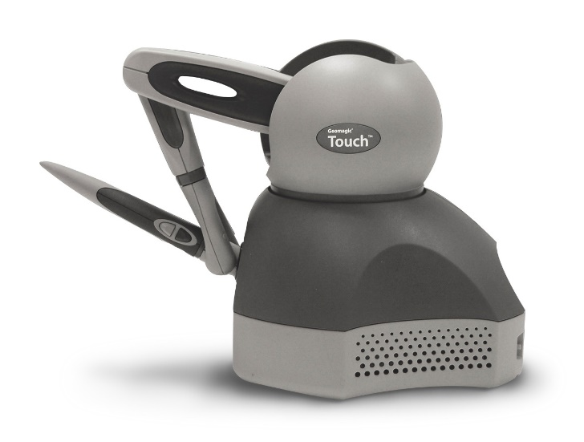
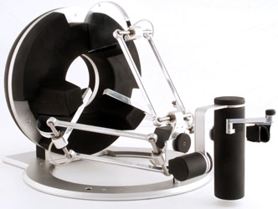
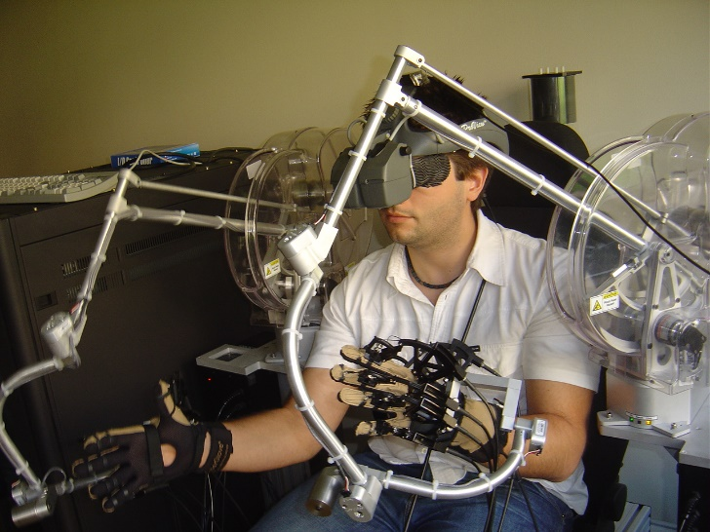
Haptic Interfaces
Robotic devices that allow physical interaction with a virtual environment or a teleoperated system.

Slide 3

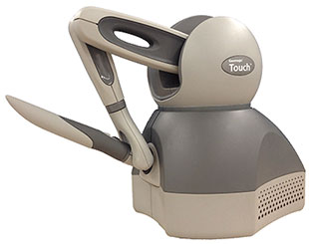
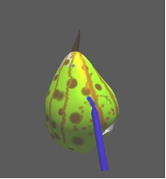
Haptic Rendering
Idea: HIP (haptic interface point) coupled with a tool in virtual space. When the tool collides with a virtual object, the user feels an artificial reaction force.
VIRTUAL WORLD
Update
tool pos, detect collisions, compute reaction forces
Move
Read HIP pos
Impose force
Send
Reaction force
Different kind of forces: Contact forces, Friction forces, Teleoperation forces..

Slide 4
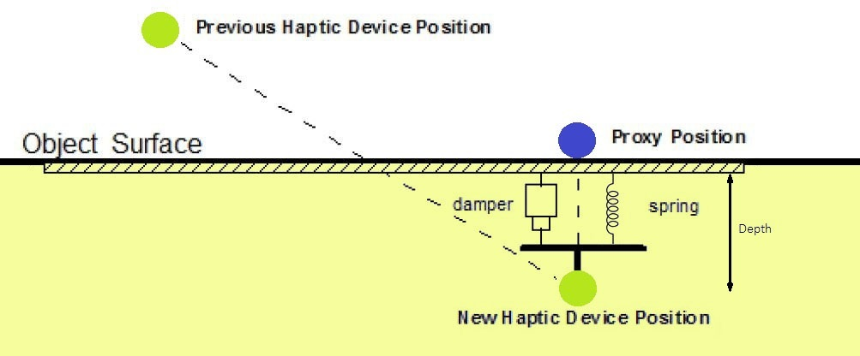

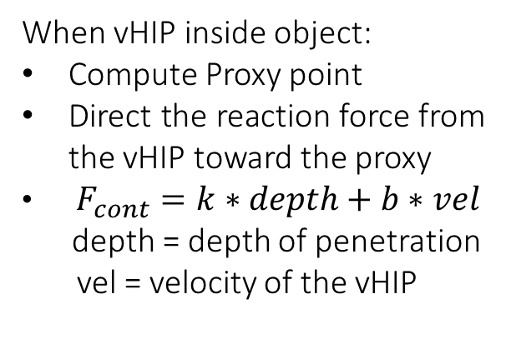
Contact Forces
Interaction between virtual HIP (vHIP) and virtual object = spring-damper system
When vHIP inside object:
Compute Proxy point
Direct the reaction force from the vHIP toward the proxy
$F_{cont}=k∗depth+b∗vel$
depth = depth of penetration
vel = velocity of the vHIP
$$F_{cont}$$

Slide 5
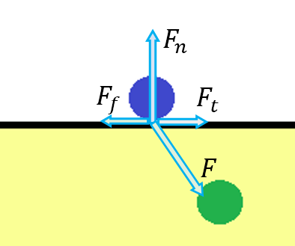
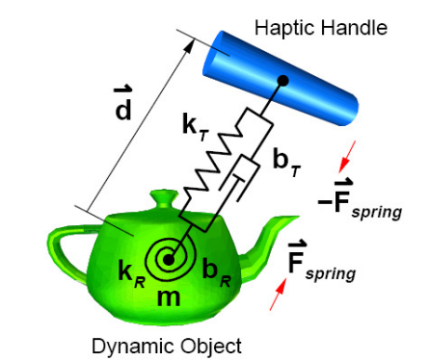
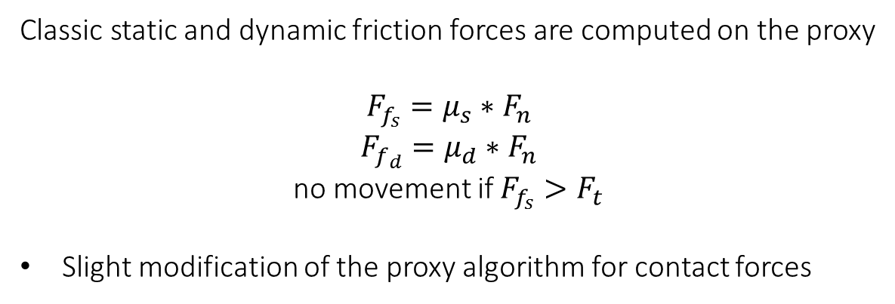
Friction Forces
Classic static and dynamic friction forces are computed on the proxy
$F_{f_{s}}=μ_{s}∗F_{n}$
$F_{f_{d}}=μ_{d}∗F_{n}$
no movement if $F_{f_{s}}>F_{t}$
Slight modification of the proxy algorithm for contact forces
Virtual coupling forces
“Feel” the inertia of a virtual body connected to the vHIP.
Typical of position/position teleoperation schemes.

Slide 6
Force Effects
Forces that arise from the movement in a portion of the space. Not linked to any virtual object.
Viscous friction
Stick-slip effect
Vibration
Constraints = Virtual Fixtures
Attractive/Repulsive forces that constraint the vHIP (then the HIP!) to a specific geometric region (dot, line, plane, surface) in the virtual environment.
Elastic/Magnetic attraction toward a constraint
Viscous friction in forbidden directions

Slide 7
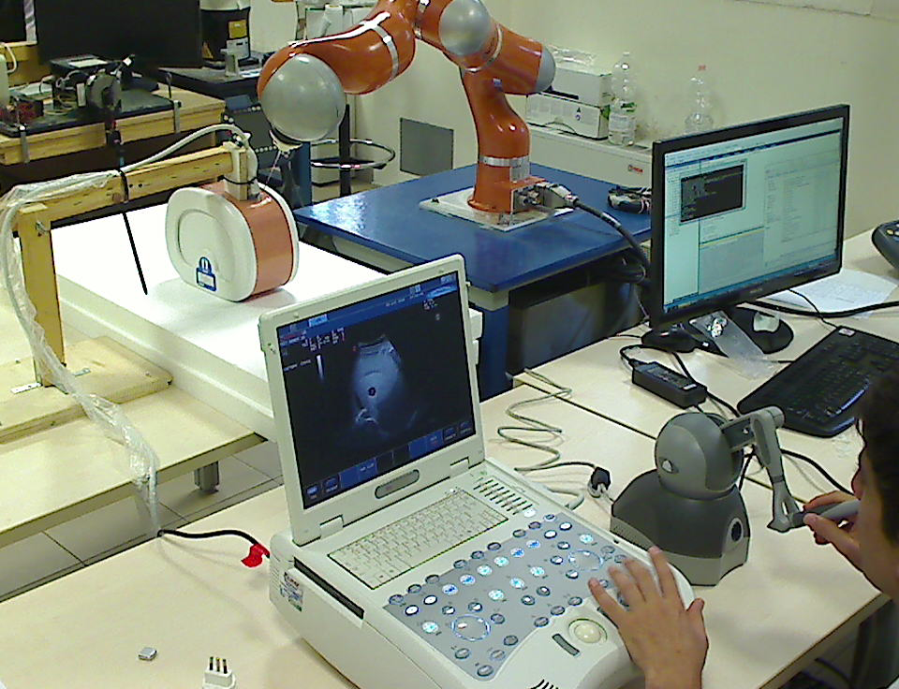
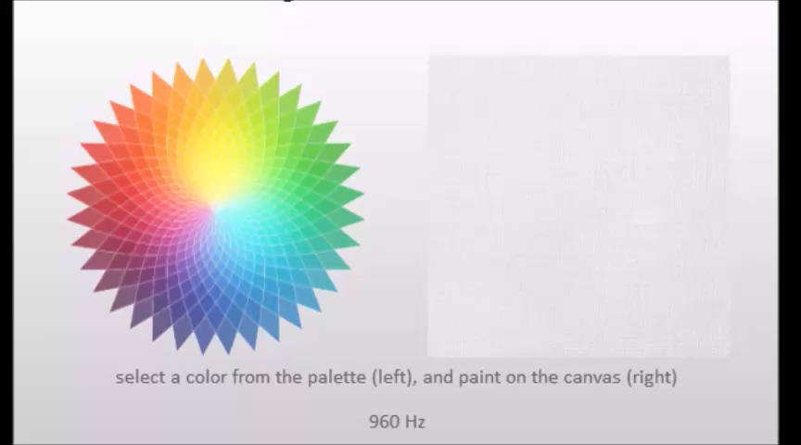
Applications of Haptic Interfaces
Touch surfaces
Manipulate objects (move, deform, decompose)
Create new object (object carving, 3D painting)
Navigation in virtual environments
Teleoperation of virtual or real robots
Coordination of a team of robots

Slide 8
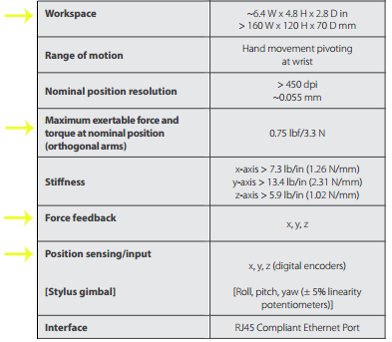
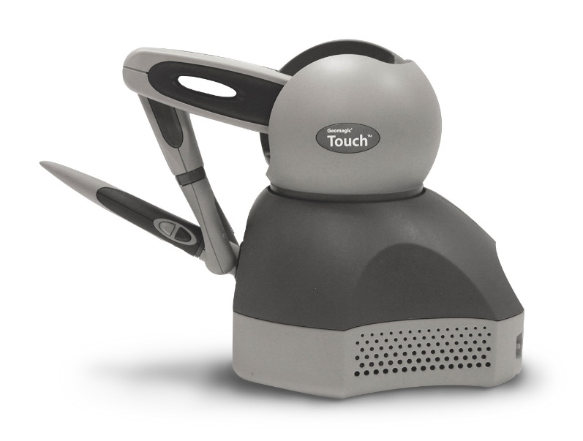
Geomagic Touch
Geomagic Touch by 3D System (previously called Phantom Omni by SensAble Technologies)
2 buttons
Compatible with OpenHaptics 3.3.0 and CHAI3D libraries.

Slide 9
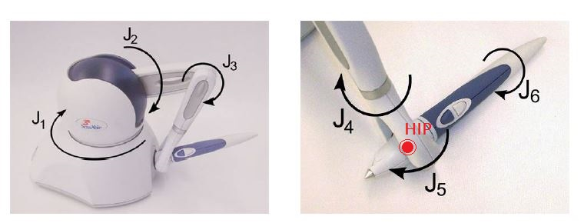
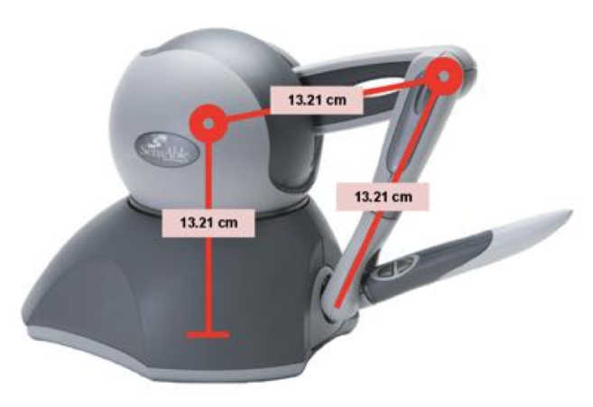
Geomagic Touch
First three joints
are actuated
Last three joints form a
passive spherical wrist
HIP (Haptic Interface Point) is the center of the spherical wrist

Slide 10
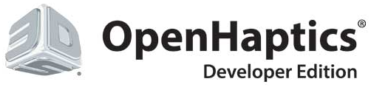
OpenHaptics Toolkit
Proprietary (3DSystems) C++ libraries that allow:
Interfacing with all the haptic devices of the Phantom family (by 3DSystems)
Development of software for the interaction with the virtual environment through the interface
Integrated graphic and haptic rendering of the virtual scene
3 groups of API from high-level to low-level: QuickHaptics, HLAPI, HDAPI
Quick haptics
Idea: High-level API for an ease setting of the virtual scene and of the graphic/haptic rendering.
What you can do with QuickHaptics:
Create simple shapes
Interact with the shapes graphically and haptically
Use pre-defined force effects
Define callbacks on contact event

Slide 11
Quick haptics (2)
What you are required to do:
Create a window where to graphically render the scene
Define the device space
Define the shapes and their properties
Define the cursor (collect informations about device and shapes)
What QuickHaptics will manage:
Insertion of many default parameters
Communication with the device
Graphic and haptic rendering
Collisions
Synchronization between graphic and haptic rendering (30Hz vs 1000Hz)
Disadvantages: API functions are very “closed”, you don’t have access to many informations and cannot perform complex tasks.

Slide 12
HLAPI
What you can do with HLAPI:
Create complex graphic and haptic scene using OpenGL formalism.
Define custom callbacks for a set of events
Define constraints (virtual fixtures)
What you are required to do:
Define shapes using openGL formalism (vertices, edges, transformations, material properties). The physical properties are treated as classical OpenGl properties
What HLAPI will manage:
HLAPI uses graphic informations to compute collisions and haptic rendering
Communication with the device
Synchronization of graphic and haptic rendering

Slide 13
Contact Forces
What you can do with HDAPI:
Read low-level sensor data from the device (joint velocities, torques)
Directly impose custom forces to the device
Define custom haptic rendering and collision detection algorithms
Define custom effects
What you are required to do:
Separately define functions for graphics rendering, collision detection and haptic rendering
Collision detection and haptic rendering algorithms must be efficient and use suitable data structures (they run once at every haptic loop iteration)
Manage the synchronization of the graphic loop (30Hz) and the haptic loop (1000Hz)
What HDAPI will manage:
Initialization and communication with the device
Disadvantage: difficult to use. Accessed data is not always as expected..

Slide 14
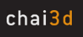
CHAI3D (Computer Haptics and Active Interface)
Open-source multi-platform set of C++ libraries for haptics and visualization
Released in 2004 by AI Lab at Stanford University + EPFL + University of Siena
Features:
Allow communication with several haptic devices (both 3 and 6 dof)
Manages graphic and haptic rendering. Has its own graphic engine (OpenGL based), provides multiple collision detection and force rendering algorithms
Allow to read/impose values to/from the haptic device
Has a clear documentation
Provides integration modules for third party softwares like V-REP

Slide 15
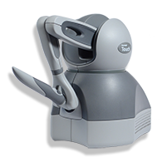
Interaction scheme between CHAI3D and V-REP
External C++ plugin
CHAI3D
DEVICE
V-REP
Haptic loop
Other C++ libraries
V-REP
simulation loop
V-REP Scene
User’s code
goes here

Slide 16
System Setting
Besides the device is recognized both in Windows and Ubuntu, the following procedure has been used and tested on Windows 10 only.
The following procedure is explained in detail in the attached guide.
Download and install Geomagic touch drivers
Download and install OpenHaptics or CHAI3D libraries
Both libraries require Microsoft Visual Studio > 2010
Note about the structure of the folders of OpenHaptics and CHAI3D
Do the pairing and calibration procedure
Run the compiled program and have fun

Slide 17
Thanks for your attention

